Slide 1
Greatness in the Kingdom
Kingdom Character
(Matt 5:1-12)
Kingdom Calling
(Matt 5:13-16)
Kingdom Conduct
(Matt 5:17-7:27)

Slide 2
Matthew 5:27-30 (ESV)
²⁷ "You have heard that it was said, 'You shall not commit adultery.'
²⁸ But I say to you that everyone who looks at a woman with lustful intent has already committed adultery with her in his heart.

Slide 3
Matthew 5:27-30 (ESV)
²⁹ If your right eye causes you to sin, tear it out and throw it away. For it is better that you lose one of your members than that your whole body be thrown into hell.
³⁰ And if your right hand causes you to sin, cut it off and throw it away. For it is better that you lose one of your members than that your whole body go into hell.

Slide 4
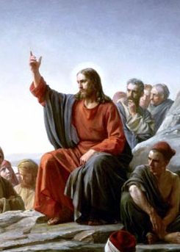
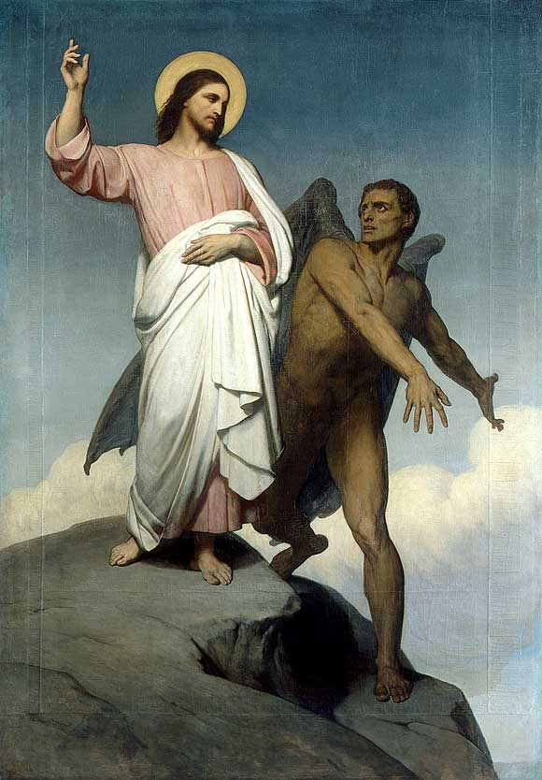
Kingdom Righteousness
“You have heard that it was said”
“It is written”
(gegraptai)

Slide 5
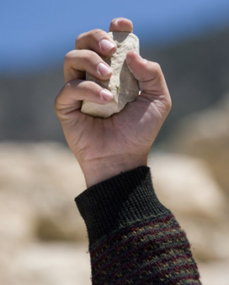
Kingdom Righteousness
¹⁴ "You shall not commit adultery.
(Exodus 20:14, Deuteronomy 5:18)
¹⁰ "If a man commits adultery with the wife of his neighbour, both the adulterer and the adulteress shall surely be put to death.
(Leviticus 20:10)

Slide 6
Kingdom Righteousness
³² He who commits adultery lacks sense;
he who does it
destroys himself.
(Proverbs 6:32)

Slide 7
Kingdom Righteousness
so careful to clean the outside of the cup
but inside you are filthy
- full of self-indulgence!
Woe to you Scribes and Pharisees!
(Matthew 23:25)

Slide 8
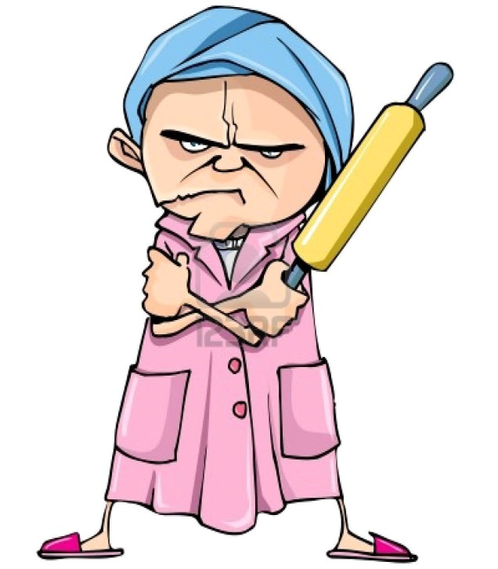
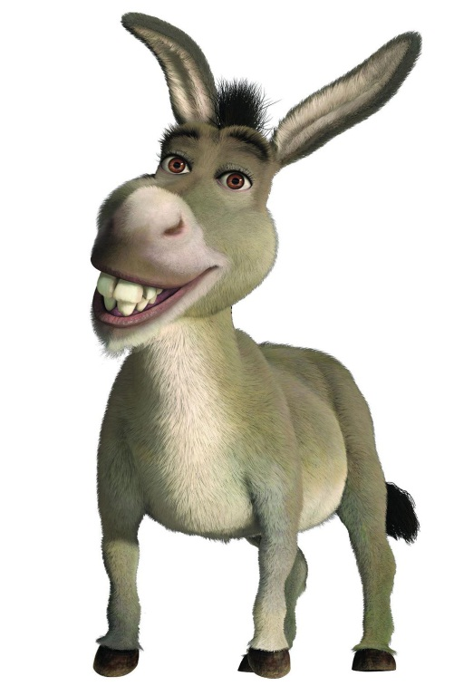
Kingdom Righteousness
You shall not covet ….
(Exodus 20:17)

Slide 9
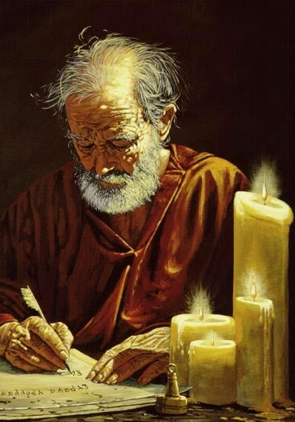
Kingdom Righteousness
It was the law that showed me my sin. I would never have known that coveting is wrong if the law had not said, “You must not covet.” But sin used this command to arouse all kinds of covetous desires within me!
(Romans 7:7-8)

Slide 10
Kingdom Righteousness
anyone who even looks at a woman with lust has already committed adultery with her in his heart.
(Matthew 5:28)
…. but I say to you ….

Slide 11
Kingdom Righteousness
Guard your heart above all else, for it determines the course of your life.
(Proverbs 4:23 - NLT)
Keep your heart with all vigilance, for from it flow the springs of life.
(Proverbs 4:23 - ESV)

Slide 12
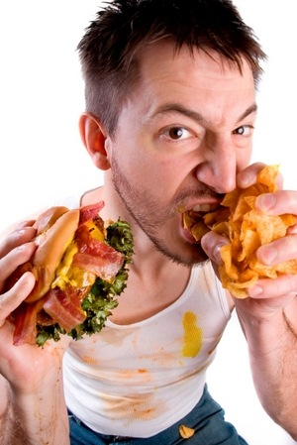
Kingdom Righteousness
“lust”
epiqumeo
strong desire
Eldership
(1 Timothy 3:1)
Angels
(1 Timothy 3:1)
develop healthy appetites

Slide 13
Kingdom Righteousness
attention
(eyes)
appetite
(heart)
action
(hand)
¹⁴ Temptation comes from our own desires, which entice us and drag us away. ¹⁵ These desires give birth to sinful actions. And when sin is allowed to grow, it gives birth to death. (James 1:14-15)

Slide 14
Kingdom Righteousness
King David’s Sin
(2 Samuel 11)
Saw a woman (v2)
Searched her out (v3)
Sent for her (v4)
Slept with her (v4-5)
Slew husband (v14-27)

Slide 15
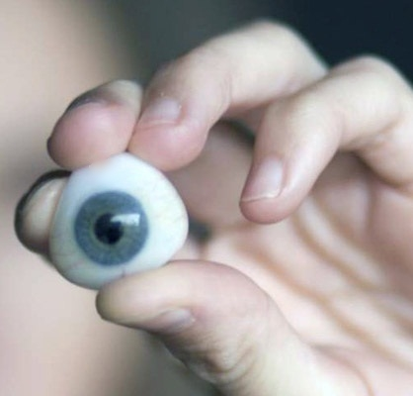
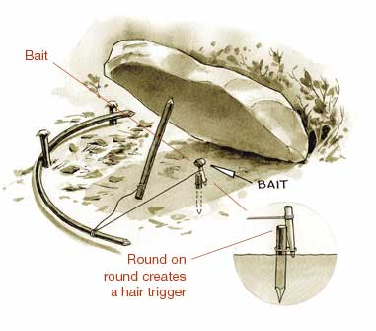
Kingdom Righteousness
If your right eye causes you to sin, tear it out and throw it away. For it is better that you lose one of your members than that your whole body be thrown into hell. (Matthew 5:29)

Slide 16
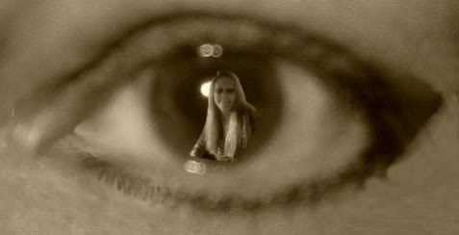
Kingdom Righteousness
¹ "I have made a covenant with my eyes; how then could I gaze at a young woman? (Job 31:1)

Slide 17
Kingdom Righteousness
⁷ "Woe to the world for temptations to sin! For it is necessary that temptations come, but woe to the one by whom the temptation comes! ⁸ And if your hand or your foot causes you to sin, cut it off and throw it away. It is better for you to enter life crippled or lame than with two hands or two feet to be thrown into the eternal fire. ⁹ And if your eye causes you to sin, tear it out and throw it away. It is better for you to enter life with one eye than with two eyes to be thrown into the hell of fire. (Matthew 18:7-9)

Slide 18
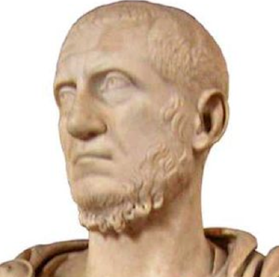
Kingdom Righteousness
sex
status
stuff
… the world offers only a craving for physical pleasure, a craving for everything we see, and pride in our achievements and possessions. … not from the Father, but from this world.
(1 John 2:16)

Slide 19
Kingdom Righteousness
What appetites are you feeding?
Who are you when nobody else is watching?
⁸ And now, dear brothers and sisters, one final thing. Fix your thoughts on what is true, and honourable, and right, and pure, and lovely, and admirable. Think about things that are excellent and worthy of praise. (Philippians 4:8)

Slide 20
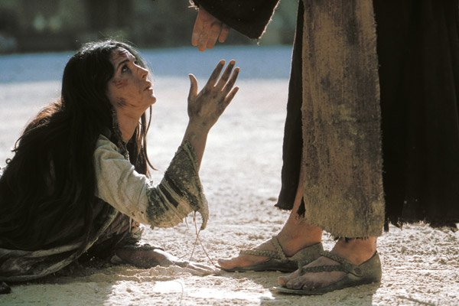
Kingdom Righteousness
And Jesus said, "Neither do I condemn you;
go, and from now on sin no more."
(John 8:11)

